Slide 1
Health and Safety Incident Reporting Presentation
January 7, 2020
Regeneration Community Services

Slide 2

JHS Committee Members
Diane Frizado-Lino |  | Co-Chair Management Rep | Cell: 416-712-4248 E-Mail: dfrizadolino@regenerationcs.org
Patricia Koine |  | Worker Rep Union Rep | Cell:647 884 4357 E-mail: pkoine@regenerationcs.org
Hillary Pickles |  | Worker Rep Union Rep | Email: hillary.pickles@regenerationcs.org
Anton Dzyubenko |  | Co-Chair Worker Rep Union Rep | Cell: 416-455-9677 E-Mail: adzyubenko@regenerationcs.org

Slide 3
JHS Committee
Under the OHSA, every worker is held personally responsible for working with regard of the health and safety for themselves and others. Every Supervisor and Manager is responsible for taking reasonable steps to ensure the health and safety of their workers. The employer has the ultimate responsibility for ensuring the necessary precautions for occupational health and safety in the workplace but can designate authority to the JHSC.
JHS Committee is dedicated to strengthening the relationship between the employer and its workers so that representation from all levels of the organization ensures open communication and that all precautions are taken to prevent health and safety hazards in the workplace.
The JHSC has no legislative authority but makes recommendations that management will carefully review. No worker, supervisor, manager, employer or government agency can hold the JHSC responsible for unsafe or unhealthy situations.

Slide 4
Importance and Purpose of Incident Reporting
Ensure that workers know how to respond and who to contact/notify in the event of a hazard, incident and/or accident in the workplace;
Bring consistency throughout operations at RCS;
Ensure compliance with RCS’s responsibility to report and keep record of hazards, incidents and accidents; and
Ensure that the appropriate authorities are notified within the prescribed time limits in the event of an accident or incident in the workplace.
If staff are ever unsure of the appropriate response, they are encouraged to contact their direct supervisor or the on-call manager. Workers should follow any suggestions made by management.
Taken from RCS Organizational Policy Procedure Manual,
Chapter F, 6.04

Slide 5
4 Types of Reports
Hazard Report
Health and Safety Incident Report
Client Member Incident Report
Work Refusal Report
* Multiple Reports may need to be completed depending on the type of the incident and persons involved e.g. Incident involving Client-Member and Staff
Taken from RCS Organizational Policy Procedure Manual,
Chapter F, Attachments

Slide 6
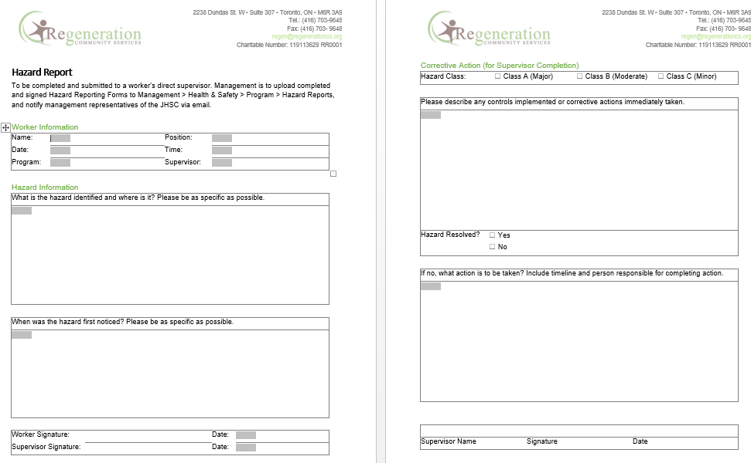
Hazard Report Form
For form insertion

Slide 7
Hazard Report Form Continued
An “occupational hazard” is a thing or situation with the potential to harm a worker.
Hazard Reporting - Workers are responsible for, on an ongoing basis, identifying and informing of any hazards to the supervisors using the Hazard Reporting Form
Supervisors shall facilitate and ensure the immediate correction, indicating any corrective actions taken on the Hazard Reporting Form. At a minimum, all hazards classified as Class A will have a safe operating procedure developed, and all workers exposed to the hazard will be trained in the safe work procedure.
Class A Hazard: Major – A condition or practice likely to cause permanent disability.
Class B Hazard: Moderate – A condition or practice likely to cause seriously injury or illness.
Class C Hazard: Minor – A condition or practice likely to cause minor, non-disabling injury or illness. For example, handling solvents without using proper protective equipment.

Slide 8
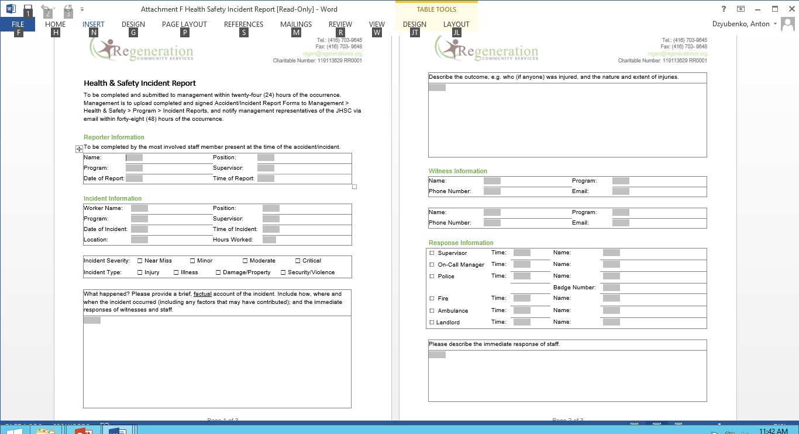
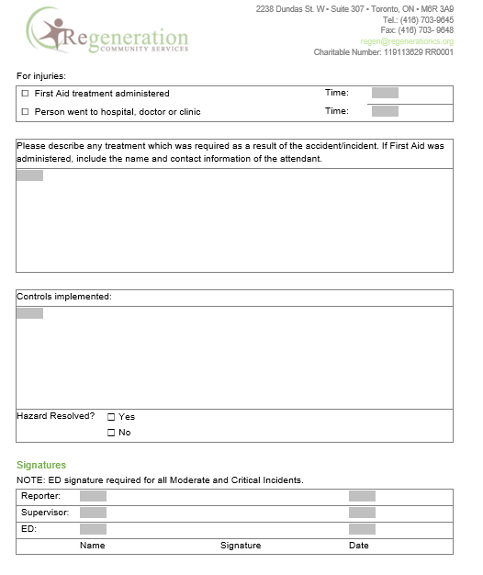
H&S Incident Report
For form insertion

Slide 9
Health and Safety Incident Report Continued
H&S Incident Report must be completed when Any workplace accident or incident (including spills or discharges) occurs.
To be completed and submitted to management within twenty-four (24) hours of the occurrence. Management is to upload completed and signed Accident/Incident Report Forms to Management > Health & Safety > Program > Incident Reports,and notify management representatives of the JHSC via email within forty-eight (48) hours of the occurrence.
Provide a brief, factual account of the incident. Include how, where and when the incident occurred (including any factors that may have contributed); and the immediate responses of witnesses and staff.

Slide 10
Severity of Accidents
Near Miss Accident/Incident – an incident where no personal injury/illness, property or environmental damage actually occurred, but could have had staff not noticed the situation and taken preventive or corrective action. An example of a Near Miss Incident would be a stove element that was left on unattended.
Mild Accident/Incident – minor personal injury/illness, and/or minor damage to property or the environment, or loss of property to any individual on RCS premises. This includes injuries that require only first aid treatment (e.g. scratches, bruises, small cuts) and property incidents that do not result in medical concerns, evacuation or isolation.
Moderate Accident/Incident – non-life threatening personal injury/illness, and/or moderate damage to property or the environment, and/or significant loss of property. This includes injuries which are likely to require medical attention, and floods or fires where short-term evacuation was required.
Critical Accident/Incident – critical injury or death, and/or severe damage to property or the environment. These events include those requiring immediate medical attention (emergency services), and property-related incidents where long-term evacuation is necessary.

Slide 11
4 types of Accidents
“Illness” means a deviation from the normal, health state of the body
“Injury” means an event that results in physical harm to a worker.
“Critical injury“ means an injury of a serious nature that:
Places life in jeopardy;
Produces unconsciousness;
Results in substantial loss of blood;
Involves the fracture of a leg or arm but not a finger or toe;
Involves the amputation of a leg, arm, hand or foot but not a finger or toe;
Consists of burns to a major portion of the body; or
Causes the loss of sight in an eye.
“Fatality” means a workplace injury resulting in the death of a worker(s).

Slide 12
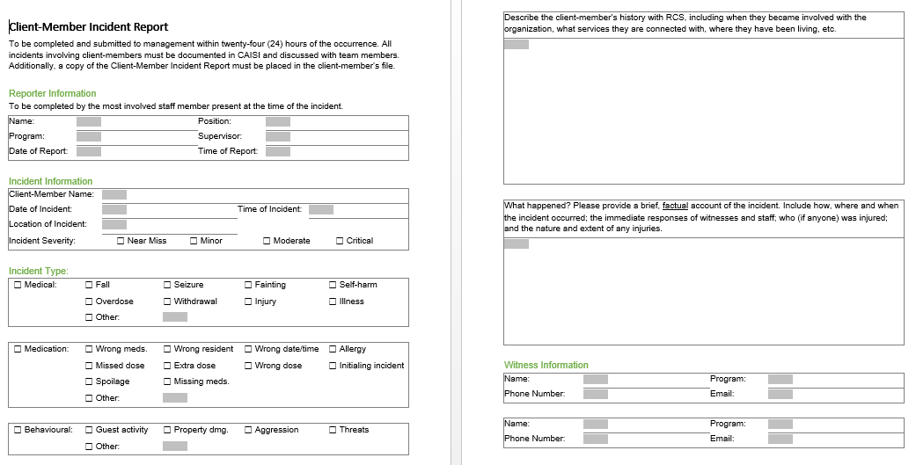
Client Member Incident Report
For form insertion

Slide 13
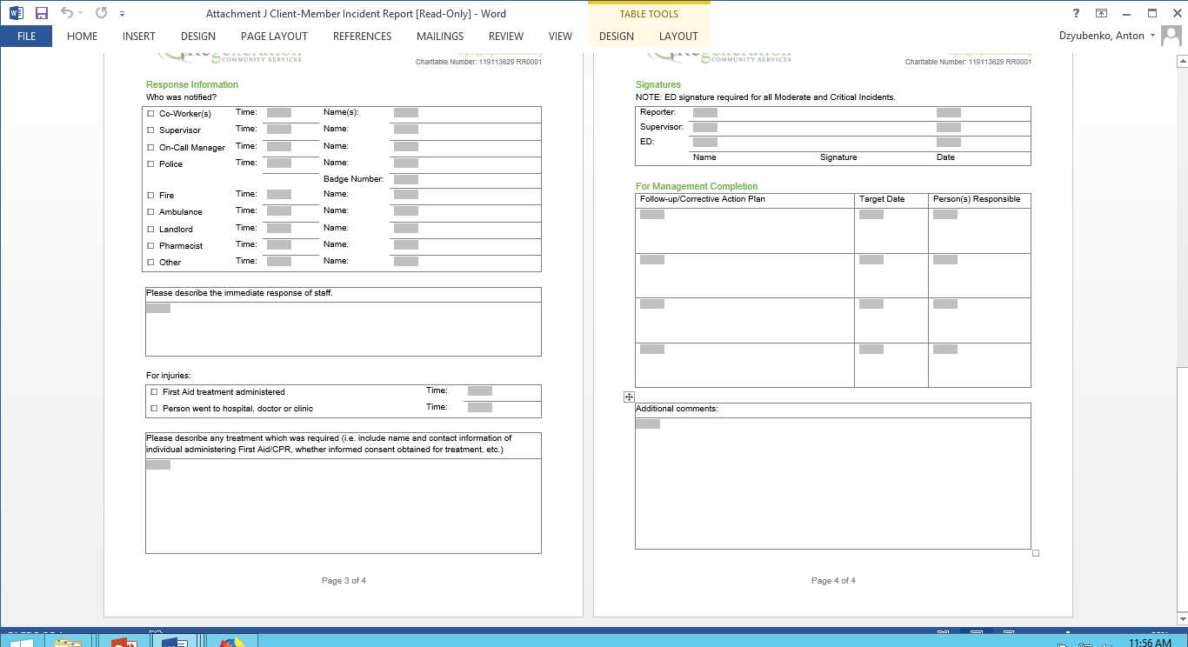
Client Member Incident Report

Slide 14
Client Member Incident Report Continued
A Client-Member Incident Report (Attachment J to this chapter) must be completed if the incident involved a client-member.
To be completed and submitted to management within twenty-four (24) hours of the occurrence. All incidents involving client-members must be documented in CAISI and discussed with team members. Additionally, a copy of the Client-Member Incident Report must be placed in the client-member’s file
Please provide a brief, factual account of the incident. Include how, where and when the incident occurred; the immediate responses of witnesses and staff; who (if anyone) was injured; and the nature and extent of any injuries.

Slide 15
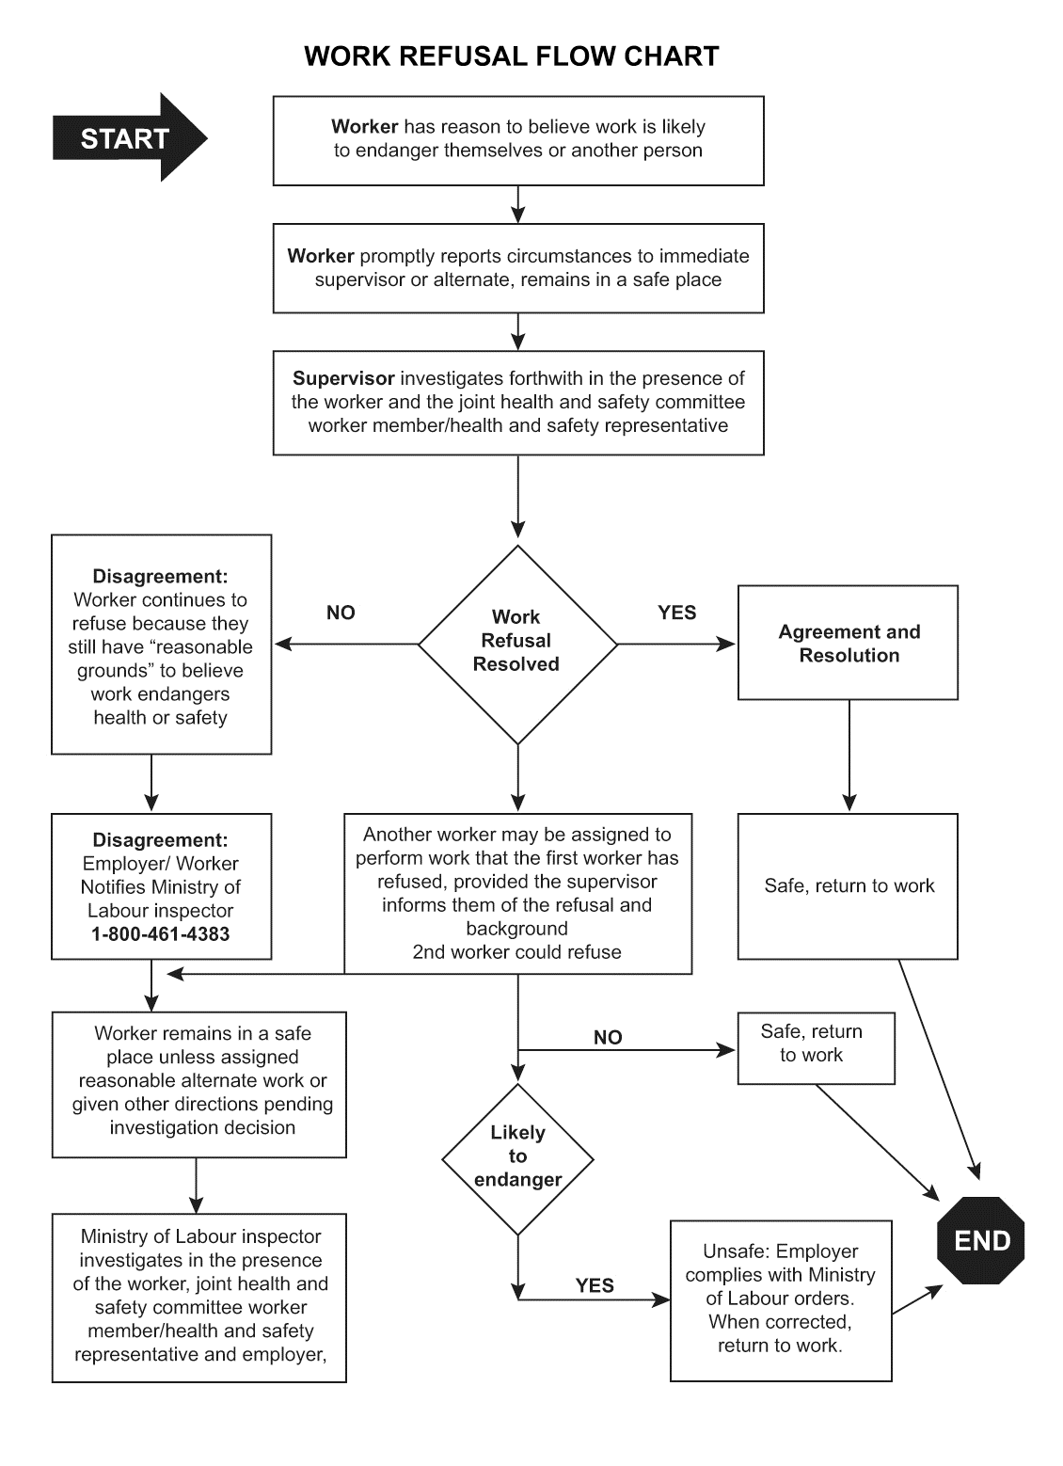
Work Refusal Report
This Report is to be completed by the employee refusing work and his/her direct supervisor. Upon a work refusal, supervisors shall assign the worker reasonable alternate job duties and immediately investigate the report in the presences of a certified member of the JHSC or, in the event that they are not available, another member of the management team. If the supervisor agrees that the situation is hazardous, corrective action shall be taken and documented below. If an agreement cannot be reached and the worker has reasonable grounds to believe that the work is still unsafe, the MOL (1-800-461-4383) shall be notified.

Slide 16
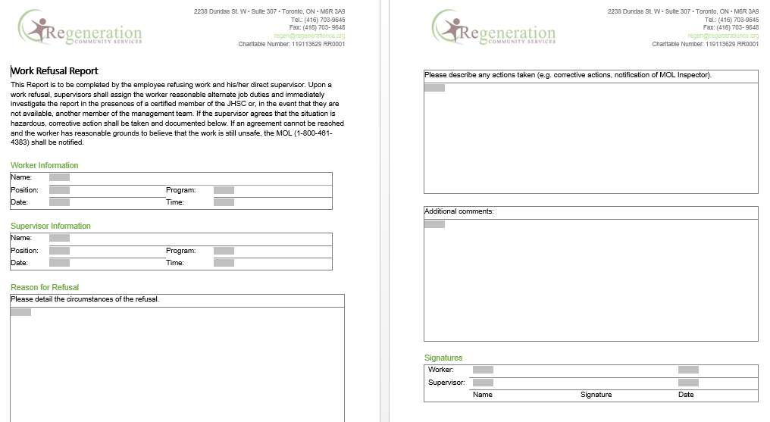
Work Refusal Report Continued

Slide 17
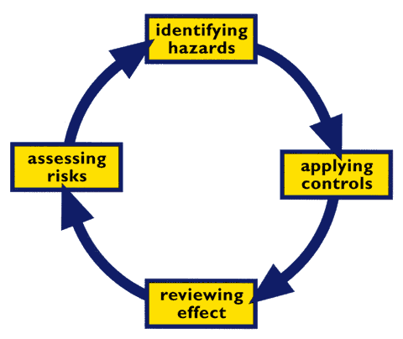
Best Practice
Please remember:
If staff are ever unsure of the appropriate response, they are encouraged to contact their direct supervisor or the on-call manager. Workers should follow any suggestions made by management.
Take support from co-worker or supervisor when needed
Be factual, concise, objective, describe your observation, avoid assumptions and diagnostic language
Include first responders information e.g. badge number

Slide 18
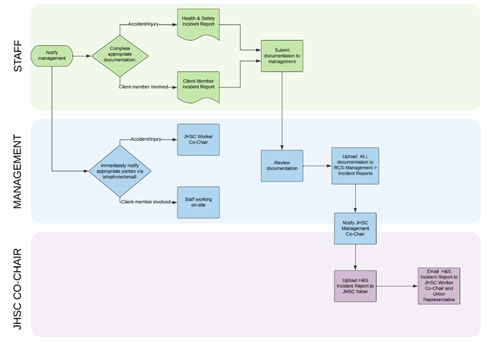
Reporting Flow Chart

Slide 19
6.04 Incident & Accident Reporting
Health & Safety Incident Report | Complaint Registration Form | Client-Member Incident Report
Accidents, fires, explosions | Human resources issues | Client-member medical, medication and behavioural incidents
Attachment F | Attachment I | Attachment J
ED signs for Moderate/Critical | ED signs all | ED signs for Moderate/Critical
Go to JHSC | Don’t go to JHSC | Don’t go to JHSC
Upload to H&S Folder | Don’t upload to H&S Folder | Don’t upload to H&S Folder

